Slide 1
APPLIED PHSICS
(SEAP-113)

Slide 2
Class Rules
80% attendance is Mandatory to appear in Final Exam.
Attendance will not be marked after 5 minutes of the starting time of lecture.
Remain Attentive in the Class.
Class Discipline is strictly observed.
No use of Mobile phone during lecture.
Participate in the Class Discussion.
Ask Questions.
Plagiarised/Copied Assignment will be marked zero.
There will be no re-test or re-quiz in the class.

Slide 3
Course Details
Credit Hours 3 (2+1)
No Pre-requisites
Course Leader: Dr. Naveed Ahmad

Slide 4
Course Assessment
Quizzes 10%
Assignments 10%
Mid Term Exam 25%
Project/Presentation 5%
Final Exam 50%

Slide 5
Books
Recommended Textbook
Fundamentals of Physics (Extended), 10th edition, Resnick and Walker
Electronic Principles by Albert Paul Malvino (7th Edition)
Electronic Devices and Circuits Theory by Robert L. Boylestad (9th Ed)
Recommended Reference
Electronic Devices (Conventional Current Version), 10th Edition Thomas L. Floyd.
And don’t forgot to browse internet for any topic

Slide 6
Course Outline
Charge, Negative and Positive charge, and Electric field
Basic concept of Voltage, Current and Resistor, Series and Parallel combinations of Resistors, Ohm’s Law, KCL and KVL
Introduction of materials, conductor insulator semiconductor, electronic configuration, P type and n type materials, doping process,
Introduction to diode theory, Approximations of diodes in circuits, some mathematical problems, Voltage and current relationship in diode, forward and reverse biasing of diodes, Zener diode and its applications
Rectifiers, Introduction to rectifiers, Half wave and full wave rectifier, Power supplies, Ripple factor and its calculations
Introduction of BJT and its operation, Collector characteristics of BJTs and region of operations, Continuation with BJT operation, Biasing of BJT, Common emitter configuration of BJT and concept of load line and Q point, Continuation with load line and Q point with some problems, Emitter bias configuration and stability of Q point
Voltage divider bias configuration and its analysis
Introduction of JFETs
MOSFETs, Basic theory of JFETs and MOSFETs, Basic calculations of JFETs and MOSFETs

Slide 7
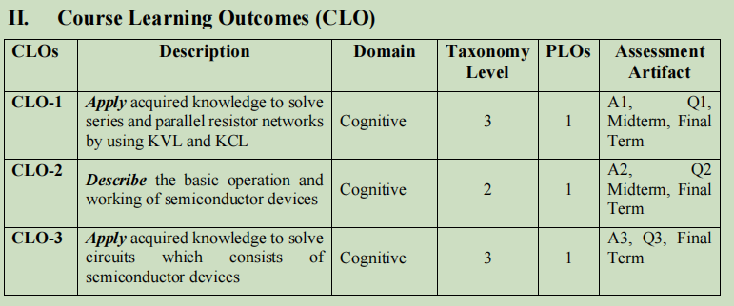
Course Learning Outcomes

Slide 8
What is meant by Applied Physics?

Slide 9
Applied Physics
Applied physics is the application of the science of physics to helping human beings and solving their problems.
It combines "pure" physics with engineering. Pure physics is the study of the basic physical properties of matter, and all that derives from it, such as energy and motion. Applied physics uses this same line of investigation to solve technological problems.
Intersection of physics and engineering.
This course focus on the Electrical and Electronics Area.

Slide 10
Electric Charge
A characteristic of a unit of matter that expresses the extent to which it has more or fewer electrons than protons.
It is the physical property of matter that causes it to experience a force when placed in an electromagnetic field.
Electric Charge Symbol q or Q
Electric charge can be positive or negative.
Like charges repel each other and unlike charges attract each other.
An object with no net charge is referred to as electrically neutral.
Electric charge exerts or experience Electric force in the presence of other electric charges
Electric field, and electric potential
Moving electric charges make current

Slide 11
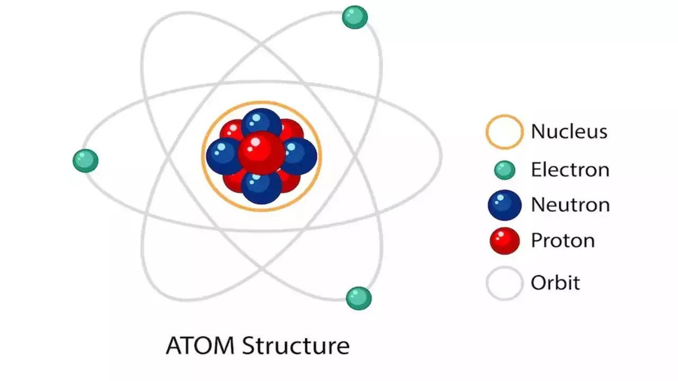
Atomic Structure
An atom is a complex arrangement of negatively charged electrons arranged in defined shells about a positively charged nucleus.
99.99% Atom is Empty.

Slide 12
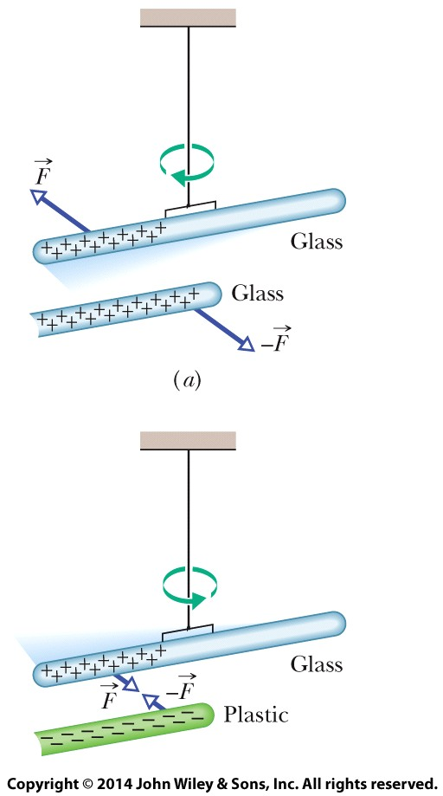

Electric Charge
Two charged rods of the same sign repel each other.
Two charged rods of opposite signs attract each other. Plus signs indicate a positive net charge, and minus signs indicate a negative net charge.

Slide 13

Force between pairs of point charges: Coulomb’s law
or
Charles-Augustin
de Coulomb
(1736-1806)
or
Coulomb’s law -- the force between point charges:
Lies along the line connecting the charges.
Is proportional to the magnitude of each charge.
Is inversely proportional to the distance squared.
Note that Newton’s third law says |F₁₂| = |F₂₁|!!

Slide 14
Coulomb’s law
For charges in a
VACUUM
k =
Often, we write k as:

Slide 15
Materials classified based on their ability to move charge
Conductors are materials in which a significant number of electrons are free to move. Examples include metals.
The charged particles in nonconductors (insulators) are not free to move. Examples include rubber, plastic, glass.
Semiconductors are materials that are intermediate between conductors and insulators; examples include silicon and germanium in computer chips.
Superconductors are materials that are perfect conductors, allowing charge to move without any hindrance.

Slide 16
Electric charges in solids
In macroscopic solids, nuclei often arrange themselves into a stiff regular pattern called a “lattice”.
Electrons move around this lattice. Depending on how they move the solid can be classified by its “electrical properties” as an insulator or a conductor.

Slide 17
Charges in solids
In a conductor, electrons move around freely, forming a “sea” of electrons. This is why metals conduct electricity.
Charges can be “induced” (moved around) in conductors.
Red circles = static positive charge (nuclei)
Blue background = mobile electrons
+
-
+
-

Slide 18
Insulator
In an insulator, each electron cloud is tightly bound to the protons in a nucleus. Wood, glass, rubber.
Note that the electrons are not free to move throughout the lattice, but the electron cloud can “distort” locally.
+
-

Slide 19
How to charge an object
An object can be given some “excess” charge: giving electrons to it (we give it negative charge) or taking electrons away (we “give” it positive charge).
How do we do charge an object? Usually, moving charges from one surface to another by adhesion (helped by friction), or by contact with other charged objects.
If a conductor, the whole electron sea redistributes itself.
If an insulator, the electrons stay where they are put.

Slide 20
Conservation of Charge
Total amount of charge in an isolated system is fixed (“conserved”)
Example: 2 identical metal spheres have charges
+1C and –2C.
+1C
−2C
You connect these together with a metal wire; what is the final charge distribution?
?
?

Slide 21
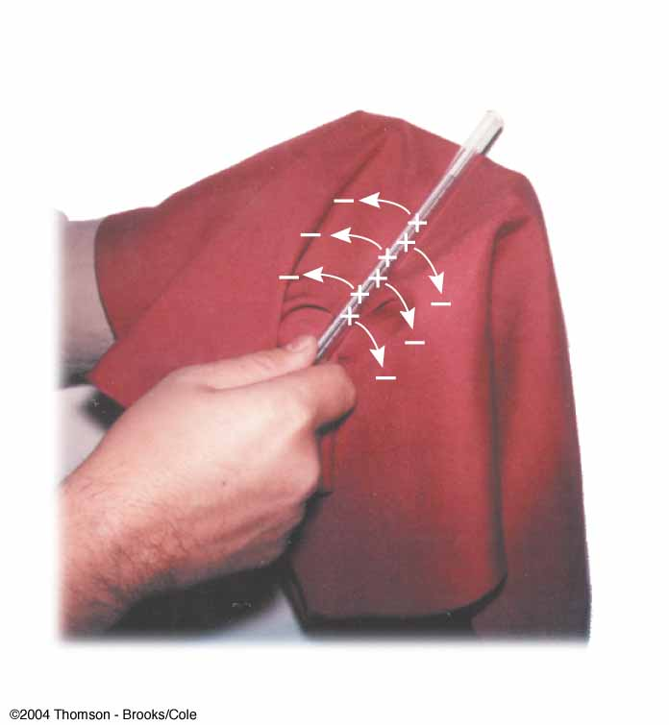
Conservation of Electric Charges
A glass rod is rubbed with silk
Electrons are transferred from the glass to the silk
Each electron adds a negative charge to the silk
An equal positive charge is left on the rod

Slide 22
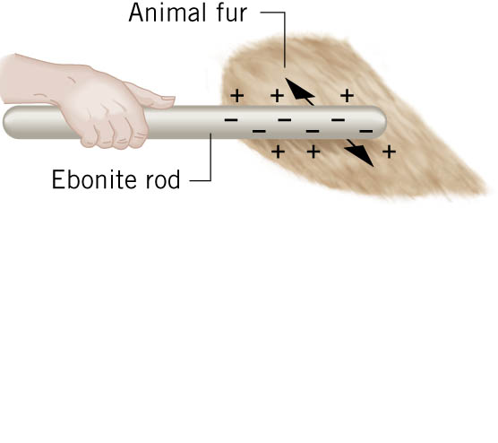
Conservation of Electric Charges
A very hard rubber rod is rubbed with animal fur
Electrons are transferred from the fur to the rubber
Each electron adds a negative charge to the rubber
An equal positive charge is left on the fur
(very hard rubber)

Slide 23
Quantization of Charge
Charge is always found in INTEGER multiples of the charge on an electron/proton
Unit of charge: Coulomb (C) in SI units
Electron charge = –e = −1.6 x 10⁻¹⁹ Coulombs
Proton charge = +e = +1.6 x 10⁻¹⁹ Coulombs
One cannot ISOLATE FRACTIONAL CHARGE (e.g. −0.8 x 10⁻¹⁹ C, +1.9 x 10⁻¹⁹ C, etc.)
Unit of current: Ampere = Coulomb/second

Slide 24
Superposition
Question: How do we figure out the force on a point charge due to many other point charges?
Answer: consider one pair at a time, calculate the force (a vector!) in each case using Coulomb’s Law and finally add all the vectors! (“superposition”)
Useful to look out for SYMMETRY to simplify calculations!

Slide 25
Coulomb’s law, Review
k =

Slide 26
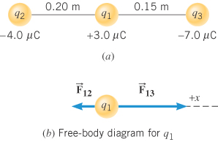
Example 1. Find the net force on q₁ ?
Soln

Slide 27
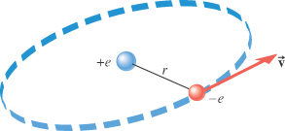
Example 3. Determine the speed of the electron in orbit about the nuclear proton at a radius of 5.29x10⁻¹¹ m, assuming the orbit to be circular [The Bohr model of the hydrogen atom]?
Soln

Slide 28
Example 2
Two 40 gram masses each with a charge of 3μC are placed 50cm apart. Compare the gravitational force between the two masses to the electric force between the two masses. (Ignore the force of the earth on the two masses)
3μC
40g
3μC
40g
50cm

Slide 29
The electric force is much greater than the gravitational force

Slide 30
Coulomb’s law (vector formulation)
Consider two fixed point charges. One is located at r₁ and has charge q₁; the other is located at r₂ and has charge q₂. The force of the charge located at r₁ on the charge at r₂ is
where is a unit vector pointing from r₁ to r₂. By Newton’s Third Law, the force F₂₁ of the charge located at r₂ on the charge at r₁ is equal in magnitude and opposite in sign.
F₁₂
F₂₁
q₂
q₁

Slide 31
Coulomb’s law (vector formulation)
Consider two fixed point charges. One is located at r₁ and has charge q₁; the other is located at r₂ and has charge q₂. The force of the charge located at r₁ on the charge at r₂ is
writing it a slightly different way. By Newton’s Third Law, the force F₂₁ of the charge located at r₂ on the charge at r₁ is equal in magnitude and opposite in sign.
F₁₂
F₂₁
q₂
q₁

Slide 32
Addition of electric forces
Electric forces add like vectors! Suppose we have three fixed point charges. One is located at r₁ and has charge q₁; the second is located at r₂ and has charge q₂; the third is located at r₃ and has charge q₃. What is the total force of the charges at r₁ and r₂ on the point charge located at r₃?
q₃
q₂
q₁

Slide 33
Addition of electric forces
Electric forces add like vectors! Suppose we have three fixed point charges. One is located at r₁ and has charge q₁; the second is located at r₂ and has charge q₂; the third is located at r₃ and has charge q₃. What is the total force of the charges at r₁ and r₂ on the point charge located at r₃?
F₁₃
F₂₃
q₃
q₂
q₁

Slide 34
Addition of electric forces
Electric forces add like vectors! Suppose we have three fixed point charges. One is located at r₁ and has charge q₁; the second is located at r₂ and has charge q₂; the third is located at r₃ and has charge q₃. What is the total force of the charges at r₁ and r₂ on the point charge located at r₃? It is
F₁₃ + F₂₃
F₁₃
F₂₃
q₃
q₂
q₁

Slide 35
Summary
Electric charges come with two signs: positive and negative.
Like charges repel, opposite charges attract, with a magnitude calculated from Coulomb’s law: F=kq₁q₂/r²
Atoms have a positive nucleus and a negative “cloud”.
Electron clouds can combine and flow freely in conductors; are stuck to the nucleus in insulators.
We can charge objects by transferring charge, or by induction.
Electrical charge is conserved, and quantized.

Slide 36
Electric Fields

Slide 37
Electric Field
The Electric Force is like the Gravitational Force
Action at a Distance
The electric force can be thought of as being mediated by an electric field.

Slide 38
What is a Field?
A Field is something that can be defined anywhere in space
A field represents some physical quantity
(e.g., temperature, wind speed, force)
It can be a scalar field (e.g., Temperature field)
It can be a vector field (e.g., Electric field)
It can be a “tensor” field (e.g., Space-time curvature)

Slide 39
A Scalar Field
77
73
72
75
82
71
84
77
80
68
64
83
82
88
55
73
66
88
75
80
88
83
90
92
91
A scalar field is a map of a quantity that has only a magnitude, such as temperature

Slide 40
A Vector Field
77
73
72
75
82
71
84
77
80
68
64
83
57
56
55
73
66
80
88
88
75
83
90
92
91
A vector field is a map of a quantity that is a vector, a quantity having both magnitude and direction, such as wind

Slide 41
Electric Field
We say that when a charged object is put at a point in space,
The charged object sets up an Electric Field throughout the space surrounding the charged object
It is this field that then exerts a force on another charged object

Slide 42
Electric Field
Like the electric force,
the electric field is also a vector
If there is an electric force acting on an object having a charge q_{o}, then the electric field at that point is given by
(with the sign of q₀ included)

Slide 43
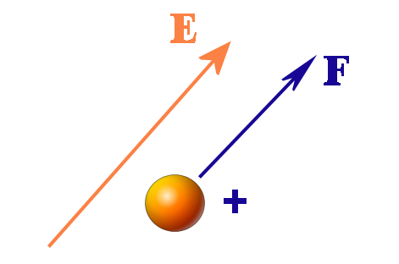
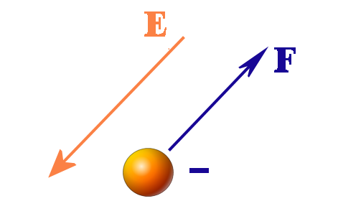
Electric Field
The force on a positively charged object is in the same direction as the electric field at that point,
While the force on a negative test charge is in the opposite direction as the electric field at the point

Slide 44
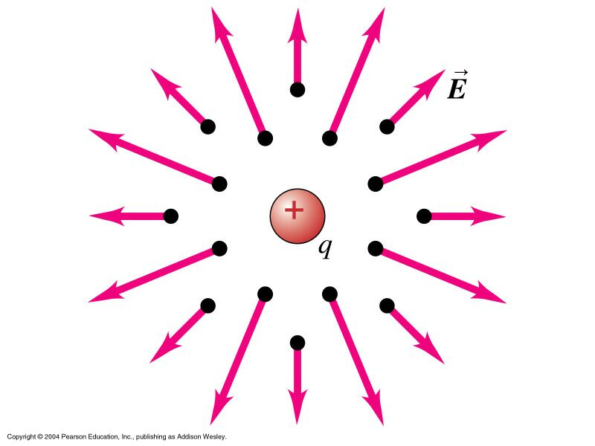
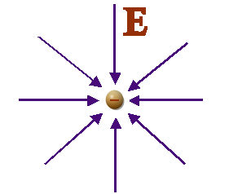
Electric Field
A positive charge sets up an electric field pointing away from the charge
A negative charge sets up an electric field pointing towards the charge

Slide 45
Electric Field
Earlier we saw that the force on a charged object is given by
The term in parentheses remains the same if we change the charge on the object at the point in question
The quantity in the parentheses can be thought of as the electric field at the point where the test object is placed
The electric field of a point charge can then be shown to be given by

Slide 46
Electric Field
As with the electric force, if there are several charged objects, the net electric field at a given point is given by the vector sum of the individual electric fields
If we have a continuous charge distribution the summation becomes an integral

Slide 47
Electric Field Lines
Possible to map out the electric field in a region of space
An imaginary line that at any given point has its tangent being in the direction of the electric field at that point
The spacing, density, of lines is related to the magnitude of the electric field at that point

Slide 48
Electric Field Lines
At any given point, there can be only one field line
The electric field has a unique direction at any given point
Electric Field Lines
Begin on Positive Charges
End on Negative Charges

Slide 49
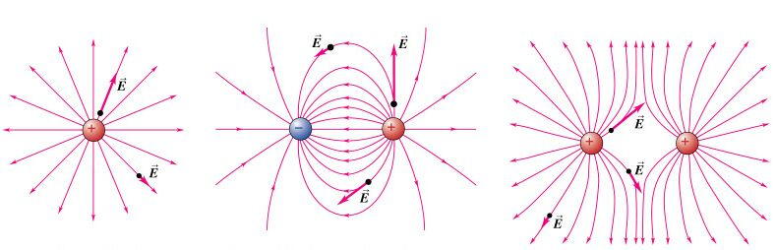
Electric Field Lines

Slide 50
Basic Concepts
Voltage
Current
Resistance

